Slide 1
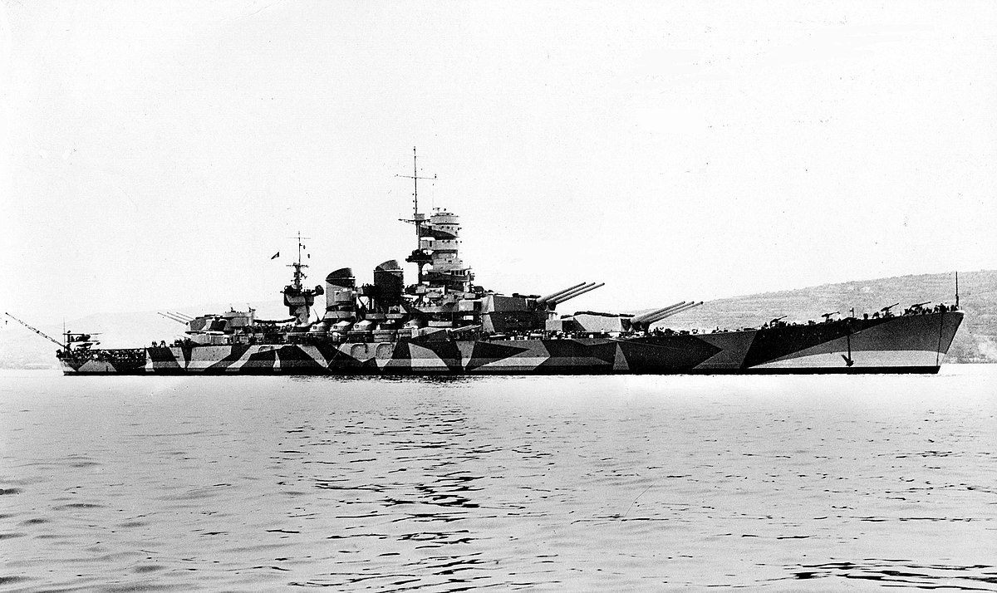
Battleship Game

Slide 2
Game Objective
Try to take down all the enemy ships before enemy sinks all of your ships. Hit and Miss will be marked on the enemy's board by guessing coordinate of where to attack.
Game Rules
Ships are placed horizontally and vertically only. They cannot be moved once they are placed.
Player has to guess enemy's co-ordinate to attack, If at that position enemy's ship is found then hit will be marked else miss.
Player wins when all enemy's ships are taken down.

Slide 3
Brief Architecture
Server Components
Socket – To start a server and maintain connection between two player
Data Structure
Client Components
Socket – To create a connection with server
GUI

Slide 4
Game flow
Establishing Connection using socket
Maintaining Sessions on server
Sending instruction and receiving responses
Next diagram shows overall flow of the game.

Slide 5
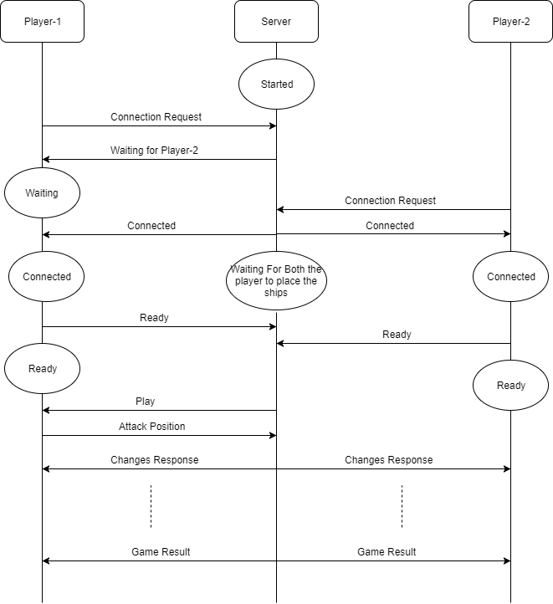

Slide 6
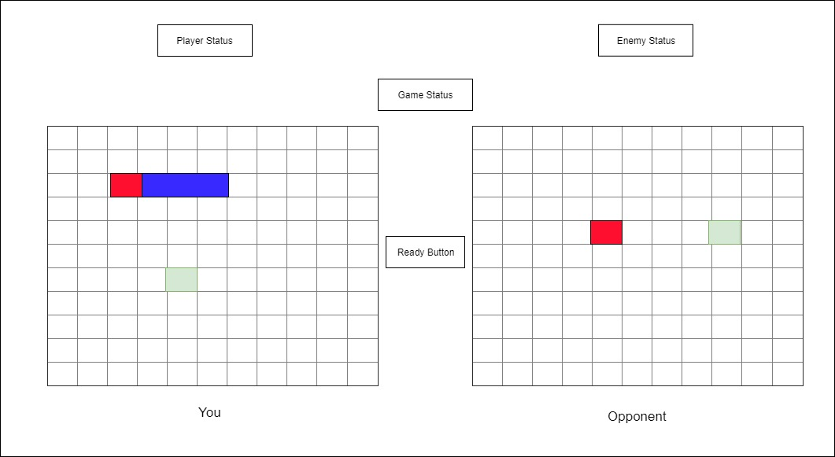
GUI Design

Slide 7
Data Structure & Winning Condition
Server maintains a list which keeps track of all the coordinates of player’s ships.
When all the ships of enemy sink then player.
Server maintains a list in which all ship’s coordinates are present, when HIT is found server removes that coordinate from the list. When list becomes empty player wins.

Slide 8
Thank You

